Slide 1

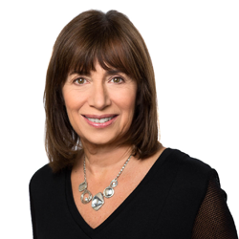
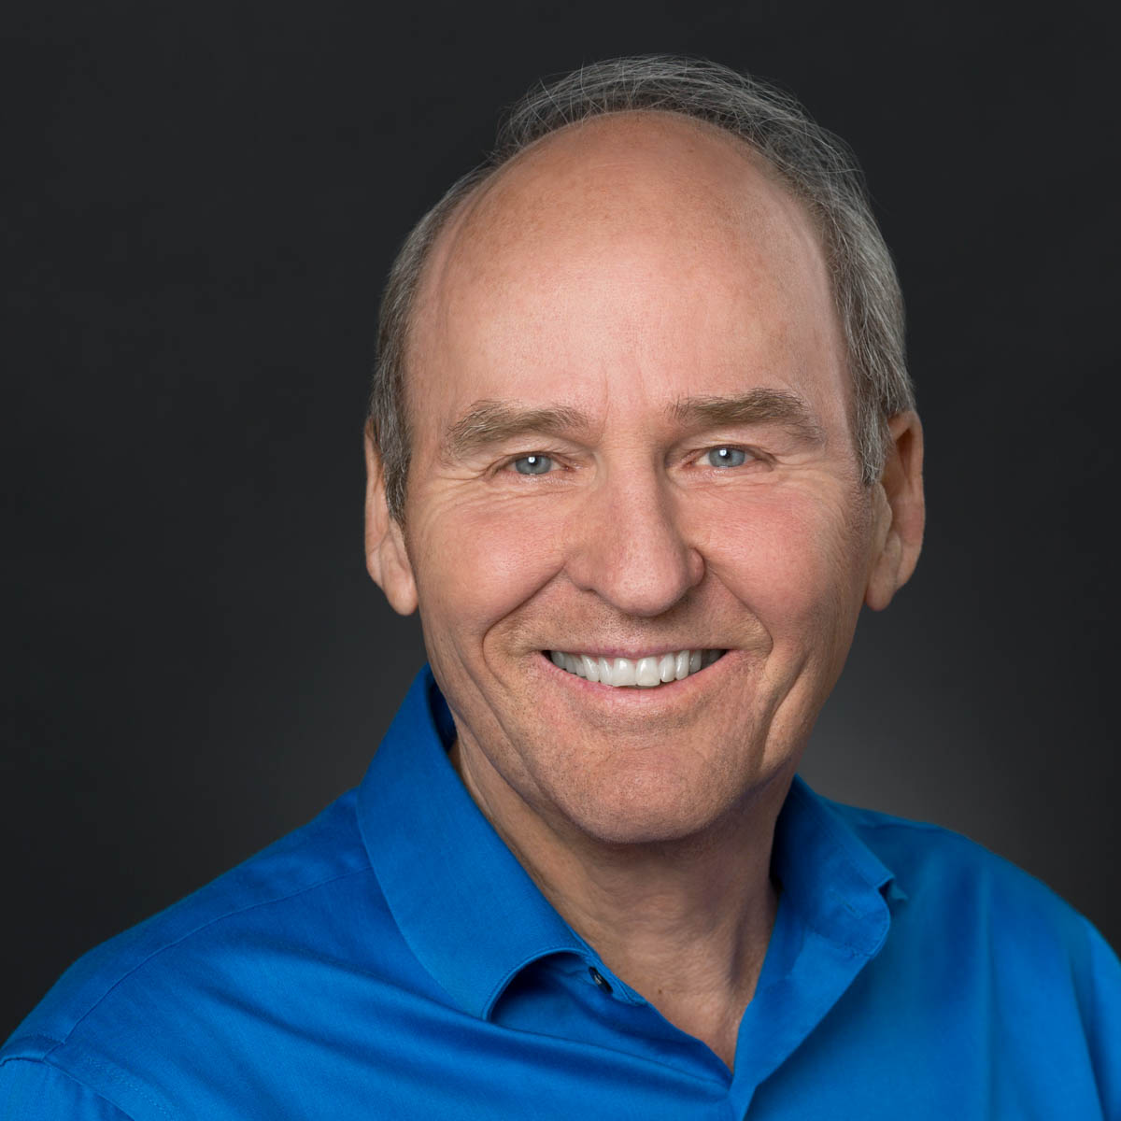
The Couples Institute
Master Mentoring Program
with Dr. Ellyn Bader and Dr. Peter Pearson
Founders of The Couples Institute &
The Developmental Model of Couples Therapy
Authors of In Quest of the Mythical Mate
Notes:
Show 2 minutes
Pete talks about the gap

Slide 2

...if you’re tired of struggling and feeling like you have to “figure it out” by yourself, there is a better way…
The Master Mentoring Program is
designed to create a transformation
in your life and your practice.

Slide 3
What is your…
Notes:
Ellyn talks about X
Would have been easier with mentors-easier and cheaper

Slide 4

Why would you search and look for another way...
You are working too hard
Want to stop trading time for money
Want to work once and get paid over and over again

Slide 5
Figuring it out by yourself is the slow, painful way to build a business. Luckily there’s another way...
Why would you struggle with problems that have already been solved by others who are further along?

Slide 6



This is a program that integrates
3 major components of success:
Personal Transformation
Business
Development
Increased Clinical Expertise

Slide 7

Personal
Transformation
The Master Mentoring Program helps you deal directly with your personal blocks.
Your creativity, resourcefulness and self-confidence will increase by leaps and bounds.

Slide 8

Business
Proficiency
You’ll get the business and marketing skills to bring your voice and talents to a larger audience.

Slide 9

Clinical
Expertise
You will master vital clinical skills to work with difficult clients

Slide 10
What’s included in the Master Mentoring Program?
Three 2-day retreats at the beautiful 1440 Multiversity
Blockages to Success: work on limiting beliefs that are blocking success
9 Personal/ Clinical webinars with time to work on your personal blocks
9 Business Building Sessions
Notes:
Write in your questions

Slide 11
What’s included in the Master Mentoring Program?
Your registration paid at Couples Conference
Free membership in Developmental Model Training Program or the Advanced Program
Access to Pete Pearson’s couples workshop materials
Website consult with our Webmaster
Access to The Couples Institute’s Developmental Model training curriculum
Operations and Systems consultation with COO, Lincoln Wachtel

Slide 12
What’s included in the Master Mentoring Program?
System and Tools
Copywriting and Email marketing strategies
Team Building
  What systems can be put in place to simplify, streamline and maximize your time
  Could tools and programs like Zoom, Slack, Basecamp, Infusionsoft help you with Communications and Project Management
  When hiring support makes sense and when it does not.
  What types of roles to hire for?
  How to hire: job posting, interviewing, personality profiles, hiring, and onboarding for success?

Slide 13
Reasons the Group Might Fit your Desire for Transformation
Leverage-Achieve More, Stretch and Reach Outside your Comfort Zone
Make More Money
Develop New Skills
Have a Community that Supports You and You Support
Make a Difference in Broader World

Slide 14

The 1440 Multiversity is nestled in the mountains
between Santa Cruz and Silicon Valley

Slide 15
This program is for you if you are:
Ready for a year of profound personal and professional growth
Not afraid to strive for your ideal clinical practice
Ready to face the change that comes with business and personal growth
Ready to push for more clinical competence with couples
Willing to learn about marketing
Willing to be part of a very welcoming and sharing community that will support you and that you will also support

Slide 16
This program is NOT for you if you are:
Satisfied with your career and the size and impact of your business
Just want a few email marketing strategies and operations insights to help your business
Aren’t inclined to share and open up to others in a safe setting
Are primarily working with individuals and are not very interested in couples therapy

